Slide 1
Publication Packages How and when to make them
Version: September 2024
changes since last version (May 2024):
Jaap-Willem Mink and WILLEMIJN PLOMP
Data Stewards Behavioural Sciences
Contact us via Datastewards_PSY_PED@FSW.leidenuniv.nl
Notes:
Willemijn: 4,5,6, 9, 10
Jaap-Willem: 1,2,3, 7,8, 11 Changes compared to the version Sep 2024 slide 4 - "first author" changed to "corresponding author (or the first author)" Changes compared to the version Dec 2023 slide 4 – made clear that publication packages of students are not uploaded to DataverseNL Changes compared to the version Sep 2023 slide 4 – publication packages are only necessary for research masters theses of Psychology students, not Education and Child Studies students
slide 6 – added preregistration slide 14 – added a solution for Mac users

Slide 2
Overview
Publication packages:
Why make them?
When do you need to make them?
How do you make them?
Questions
(Bonus material)

Slide 3
WHY MAKE A PUBLICATION PACKAGE?
National Guidelines & Open Science policy
Funder and journal requirements
Prevents data loss
Integrity and transparency
Reproduce results and replicate experiments
Reuse data
Reuse code, materials, software
Get more citations when people reuse your data

Slide 4
When do you need to make a publication package?
You are the corresponding author (or the first author) and the data are stored on a Leiden University Server
Published empirical studies
Empirical studies appearing in (unpublished) PhD thesis chapters
Psychology research master theses (just for educational purposes, these packages are not uploaded)
Notes:
If you're not sure whether you need to make one, you can always email us!

Slide 5
How do you make a publication package?
Step 1: Create a publication package
Step 2: Fill in our Formdesk questionnaire
Step 3: Share your publication package with the data stewards

Slide 6
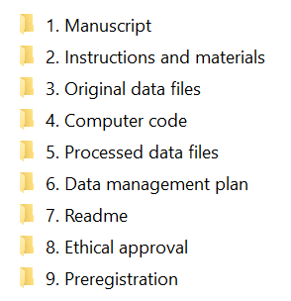
Step 1: Create a publication package
All the materials necessary to...
…replicate the study
…reproduce the results
…reuse the data
Archiving instructions can be found here!
README template can be found here!

Slide 7
Step 1: Create a publication package
To protect your participants' privacy, don't include:
Participant's names, email addresses, etc.
Conversion key (document that links participants to their code)
Videos or photographs of participants (in most cases)
In-depth interviews that cannot be de-identified
Make the data less sensitive:
Age instead of date of birth, age categories instead of absolute age
Transcripts instead of video/audio files
Deface MRI images
If possible, remove identifiable variables

Slide 8
Step 1: Create a publication package
Tips: - Start making your publication package during your project, not afterwards.
- Ask a member of your team to take a look at your package before submitting it.

Slide 9
Step 2: Fill in our Formdesk questionnaire
We need some information about the dataset:
Contact persons
Keywords
Which files you want open, upon request, and closed
Etc.
The form can be found here

Slide 10
Step 3: Share and inform the data stewards
J-Drive: J:\ResearchData\FSW\Archivering DataverseNL\<your department or institute>
OneDrive
SurfDrive
Add a (unique) password if necessary - don't forget to send it to us.
Inform the data stewards that the publication package is ready: datastewards_psy_ped@fsw.leidenuniv.nl
Notes:
Please don't use dropbox or googledrive to share personal data.

Slide 11
What happens then?
We, the data stewards, will check if the publication package
is complete
Does not contain (too much) sensitive or identifiable information.
We will contact you if we have any questions or concerns.
We will then upload the publication package on DataverseNL. The package will get a DOI (permanent link) that you can share. (You can also request the DOI prior to the publication so the link can be added to the paper.)

Slide 12
Questions?

Slide 13
Bonus material
- How to password-protect files - What to do with MRI data - Can I add an embargo - What if a funder/journal wants proof of data sharing - How to find data to reuse
- What to do if you've used another repository
- How to write better code for reproducible research

Slide 14
How to password-protect files
You can zip a file or folder & add a password to it with 7zip
If you don't have 7zip you can download it in the software center
Right-click on the file/folder and choose 7zip, choose "Add to archive..." And enter a password.
Don't use your ULCN password! Choose a unique password for every study.
Mac users: if 7zip doesn't work, try alternative zip programs

Slide 15
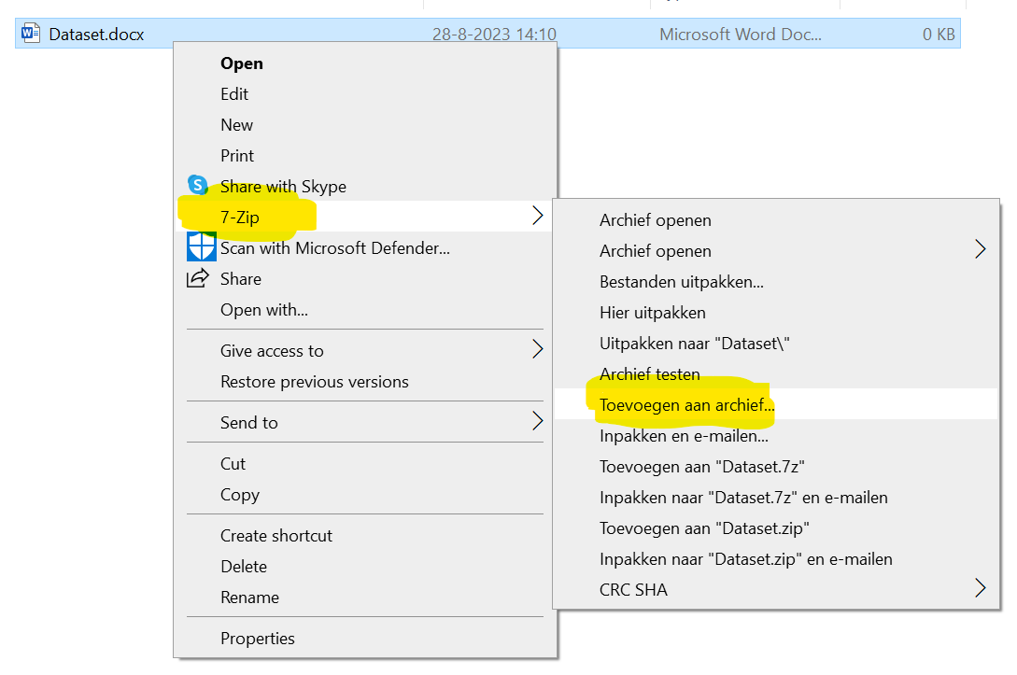

Slide 16
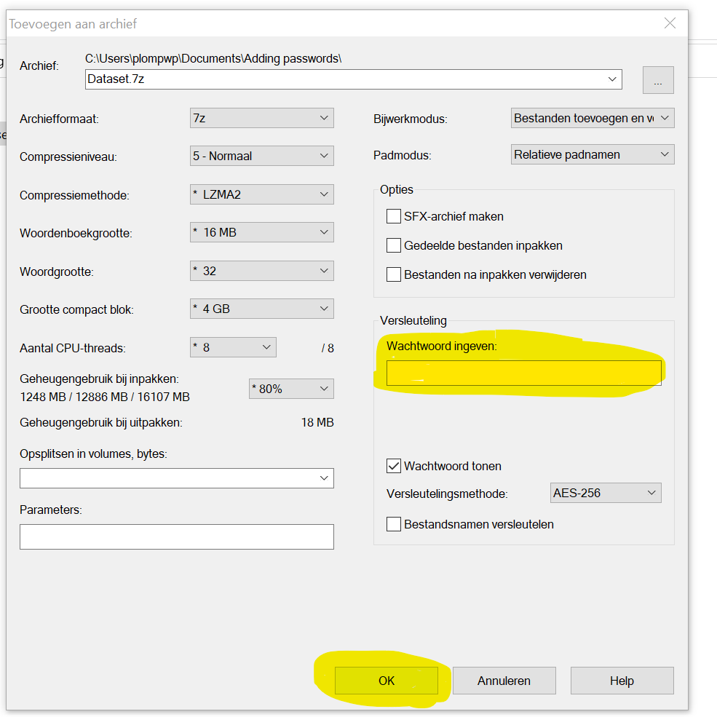

Slide 17
Can I add an embargo to my data?
- Yes, you can choose to embargo your publication package for any period of time.
The embargo can be added at file level, so you can decide whether to set the entire publication package under embargo or just a small part.
The embargo can be removed or changed at any point by contacting the data stewards

Slide 18
What to do with mri data
MRI Data Sharing Guide - this flowchart helps you think about whether, and how, you can share your MRI data.
fMRI data are much smaller and form less of a privacy risk. They can be shared in most repositories.

Slide 19
What if a funder/journal wants proof of data sharing?
You can include the DOI to your publication package in the paper. Ask the data stewards to reserve a DOI for you.
The data stewards can provide a temporary link to the draft version of your publication package, or a screenshot. This link expires upon publication of the dataset.

Slide 20
How to find data to reuse
DataverseNL: https://dataverse.nl/ Google Dataset Search::https://datasetsearch.research.google.com/ or google "dataset search"
Open Science Framework: https://osf.io/
Open Neuro: https://openneuro.org/

Slide 21
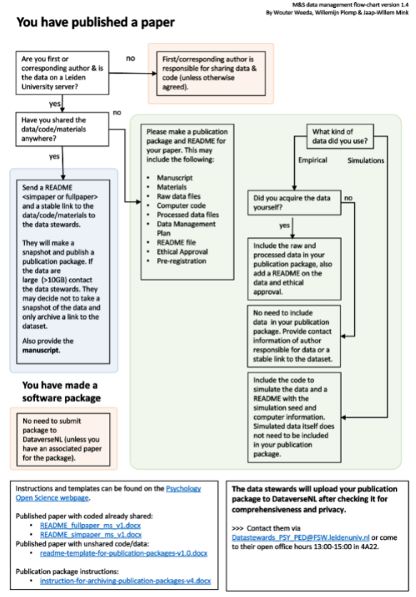
What if you have used another repository?
There are specific README templates for PSY M&S publication packages, see Open Science - Leiden University (universiteitleiden.nl)

Slide 22
How to write better code for reproducible research
Better coding for reproducible research 10.5281/zenodo.13644575 by Philippa Johnson

Slide 23
Read more
Open Science - Leiden University (universiteitleiden.nl) or the Research Data Management channel on IPW Teams these pages contains Leiden Behavioural Science templates for DMPs and Publication packages as well as information about Open Science good practices.
Open Science - A Practical Guide for Early-Career Researchers - Universiteit Leiden
What is pseudonymous, de-identified or anonymous data? A Visual Guide to Practical Data De-Identification

